Slide 1
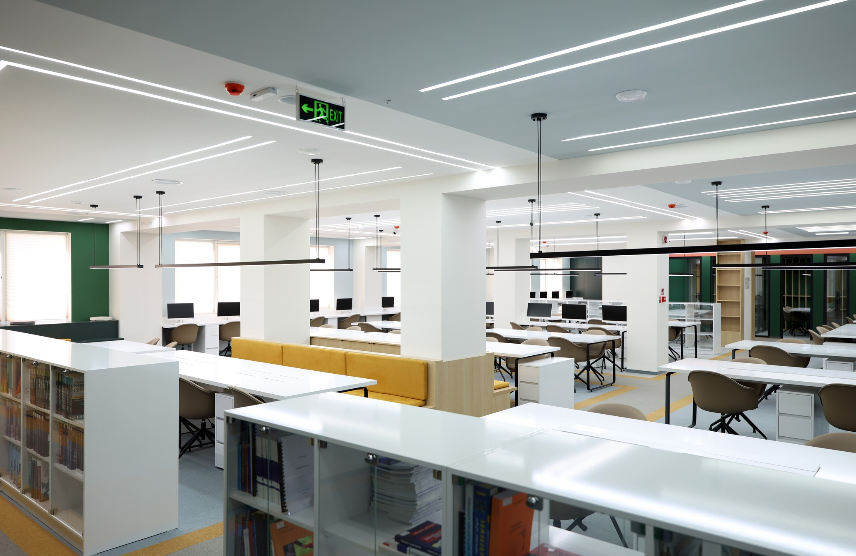
How to electronically reserve a room in the library

Slide 2
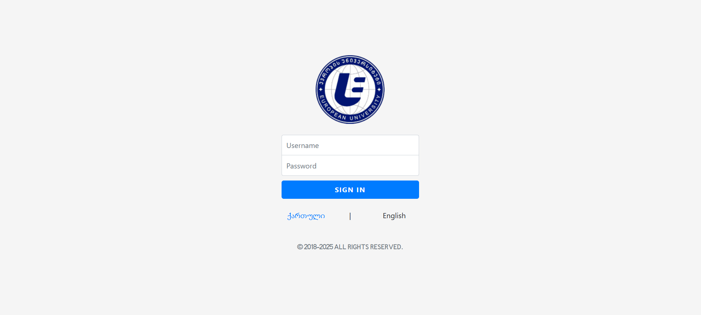
First, go to the website - https://eunsis.eun.edu.ge/ - and enter your information.

Slide 3
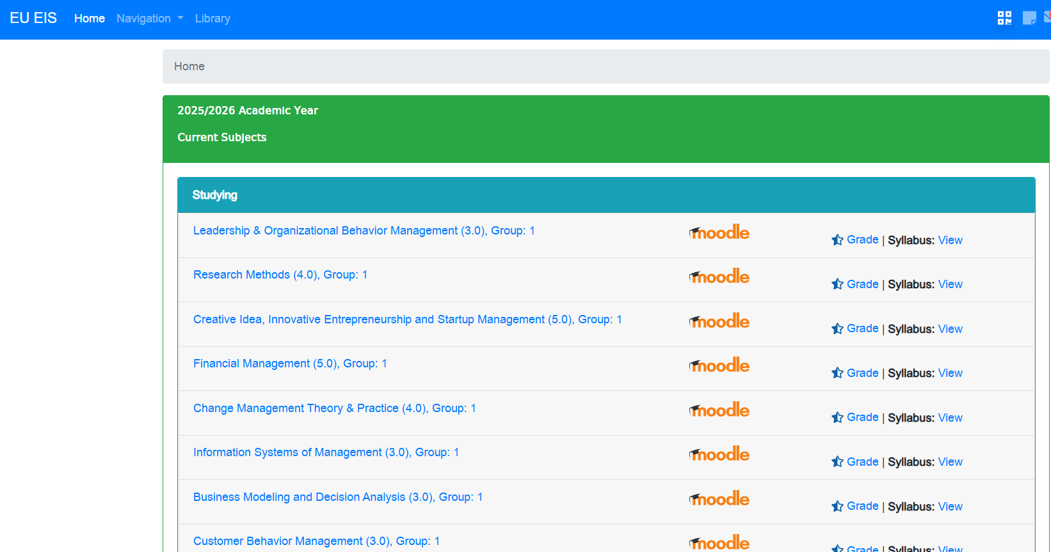
Select “Library” in the top-left corner.

Slide 4
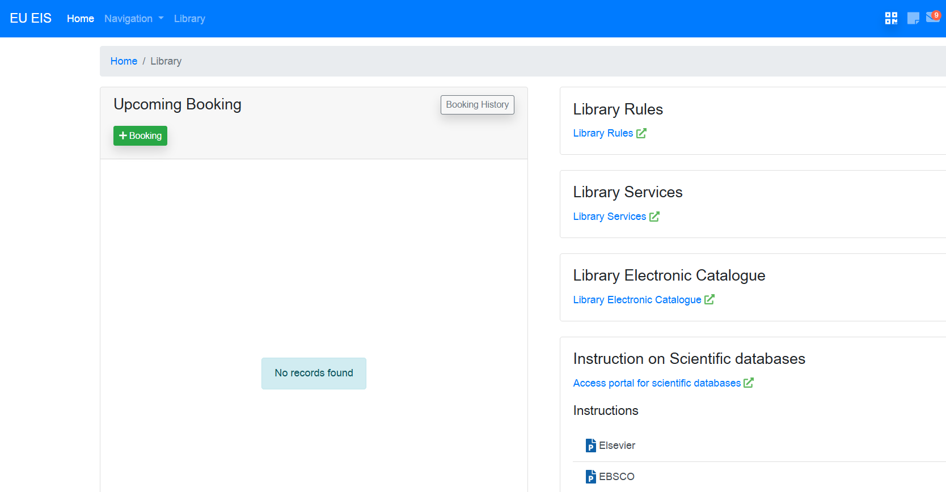
There is a booking column. Click the 'Booking' button outlined in green.

Slide 5
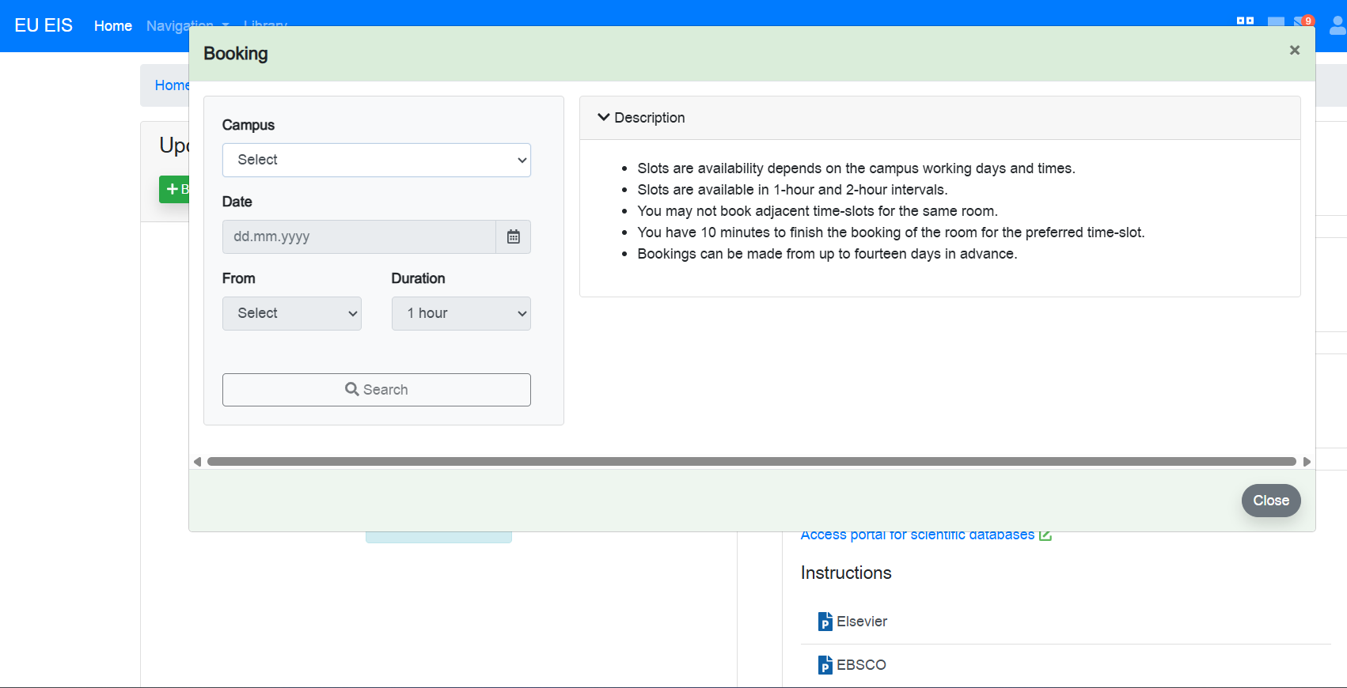
A column will appear where you can select the building, date, and duration. You also need to specify the students first and last names, which the system will automatically display in a list

Slide 6
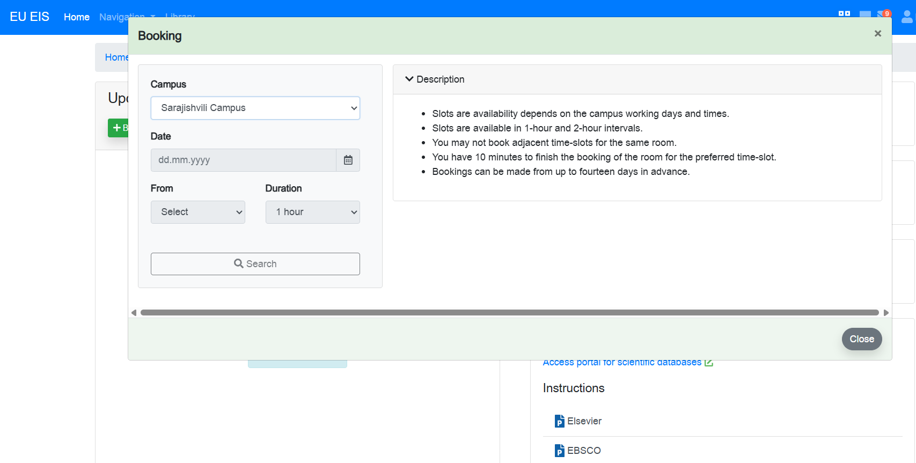
If you select the Sarajishvili building, you can choose a room equipped with Anatomage tablets

Slide 7
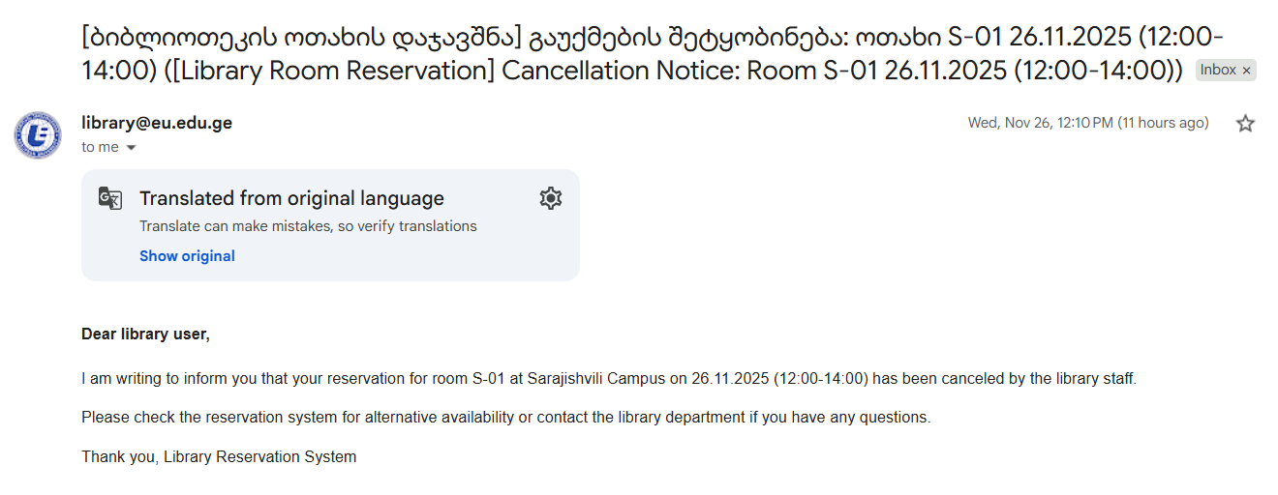
If a student doesn't show up within 15 minutes, the staff member has the right to cancel the reservation.
The student will receive an email about the cancellation.
Additionally, if students are unable to arrive at the scheduled time, they can cancel the reservation themselves in the system.

Slide 8
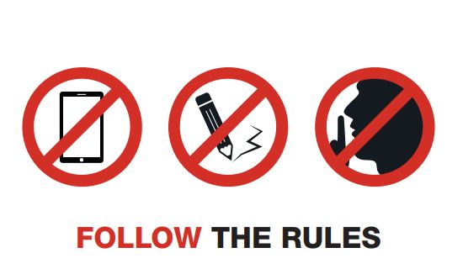
The following are not allowed in the library:
Talking loudly,
Bringing in food,
Bringing in drinks (only water is allowed),
Smoking cigarettes or electronic cigarettes,
Talking on a mobile phone,
Damaging books, journals, or computer equipment,
Watching movies,
Using group study rooms for unintended purposes,
According to the established rules, both mobile games and any type of gambling are prohibited

Slide 9
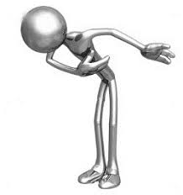
Thank you for your attention.

